Slide 1
Squads proposal
May 2020

Slide 2

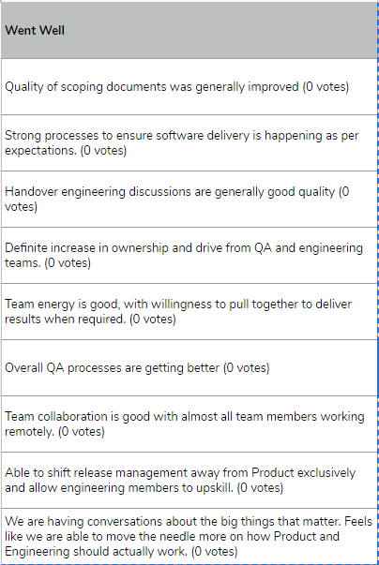
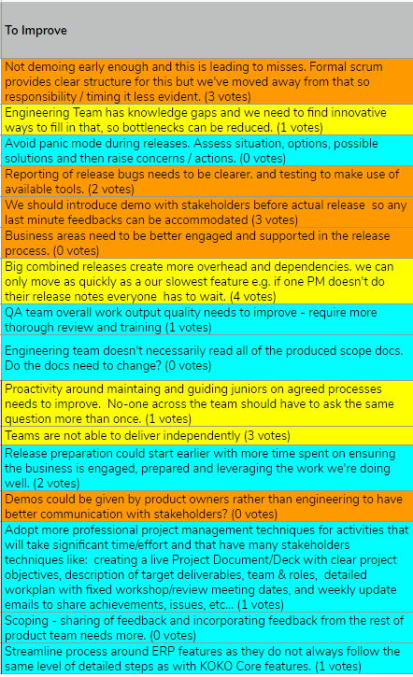
R35 - business feedback and retrospective
Success themes:
Investment in process definition and adherence is slowly paying off
Product and Engineering team interactions are working quite well
Improvement themes:
Still need to work on process adherence / discipline (7)
Business engagement needs to be stronger (5)
Team / org improvements (4)

Slide 3
How could the squad model play a role in improvements for the second half of 2020
A squad is an autonomous team of product, engineering, qa and business analysts who serve a single business area. What goals would be achieved by forming squads:
Business engagement and alignment
Tighter alignment between all team members and business
Define own mission, product strategy, short term goals and business KPIs for each squad
Team related benefits
Operate autonomously covering
Development cycle (Design, Develop)
Release process (Deploy)
Integrated product and technical support (Maintenance)
All team members focus on what problem to solve relevant to the business area
Deepen expertise of all team members in relevant areas
Drive architectural improvements that support independent releases by squads
More efficient and predictable team member allocation
Own definition of awesome!
Squads reading
https://medium.com/@achardypm/agile-team-organisation-squads-chapters-tribes-and-guilds-80932ace0fdc
https://labs.spotify.com/2014/03/27/spotify-engineering-culture-part-1/ (nice 2x 15 min vids)
https://www.productplan.com/product-squads/

Slide 4
Customer Squad
Product / Process Areas
Customer Sales
Customer Support
Customer Marketing
Customer Payments
Customer Financing
Products supported today
KOKOpoint (customer elements), myKOKO
KOKO Admin for CC and Marketing
KDM and DMP for fuels
VoIP Call Centre
Zendesk for customer support
KSPS for customers
Team members:
Product: Alice, Nyawira, Billy
Android: Rowland, Isaac
Server: Heet, Davinder, Akshay, Renuka
Quality: Uday, Margaret, Quentin
User experience: Rahul
Concerned departments
Customer Sales
Customer Care
Marketing
Finance

Slide 5
Network Ops & Fuel Supply Squad
Product / Process Areas
Fuel distribution
Network operations, monitoring and maintenance
KP / STS / SDS vXX design, maintenance & upgrades
VIVO support
Products supported today
KOKOpoint SW (fuels elements) and HW
Tanker and depot SW and HW
KOKO Admin for Fuel distribution
KOKO Admin for Network Operations
Grafana
KSPS for fuels
Team members:
Product: Tim, Linda, Ceesay
Android: Kevin, Brian
Elec/Mech: Charlton, Henry, Evans
Server: Anand, Dhananjay
Quality: Charles, Charlene
Concerned departments
Fuel distribution
Network operations and maintenance
KP / STS / SDS Assembly and Manufacturing
KNK Finance
Notes:
Integrate team members from production engineering into this squad to provide complete ownership over fuels tech.
Much of their work now should be coordinated with this group and logically fits under its product ownership

Slide 6
Agent & Cooker Supply Squad
Product / Process Areas
Agent Onboarding and Lifecycle Management
Agent Payments
Distribution of stoves and cookers
Reverse logistics?? Cooker Repair Services?
Cooker manufacturing & QA
Main products supported today
UVA (Agent Lifecycle Management ? )
KSPS for Agents
Odoo purchasing and invoicing
Odoo manufacturing
KOKO mile
KNI
Team members:
Product: Madhav, Sid, Violet(SW)
Product Support: Peter Mudoko
Android: Sudarshan, Komal
Server: Sameer, Divyesh, Prashant, Hemangi
Quality: Yogesh, Sidheshwar (joining)
Concerned departments
Agents Team
KNK Procurement
KNK Cooker Distribution & Service
KNK Finance
Saarus

Slide 7
What would be different vs today
Easier?
Team member allocation within squad decided between product and engineering leads
Product and Tech support replicated across squads e.g. cc-squad.support@kokonetworks.com
Harder?
Progress and priorities review can happen at business area level between squad leads and exco stakeholders (or their delegates) at cadence to be decided within business area.
Release testing and management run independently by each squad. Any squad has the power to break KOKO services!
Process agreement (and adherence) will be relied on, so squads can operate independently without issues.
Driven proactively by product and engineering team leads in each squad
Notes:
Priority meetings and team planning?

Slide 8
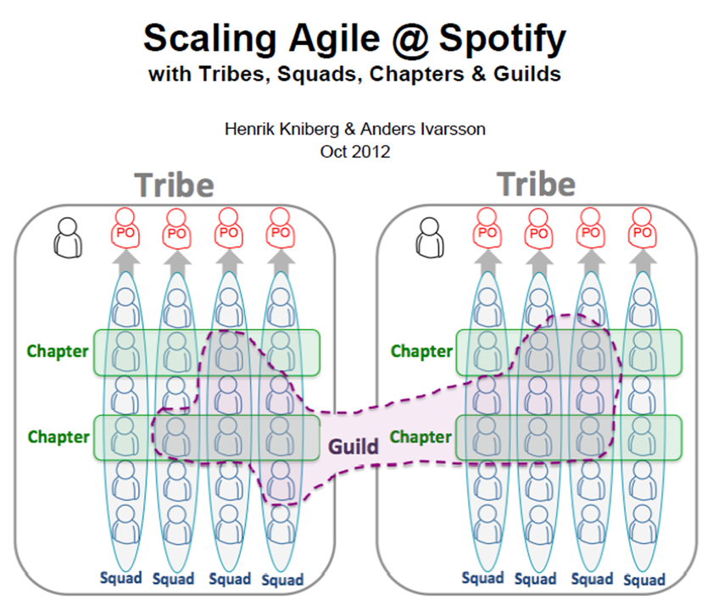
Interactions between squads
Co-operation and communication necessary to:
Coordinate release activities on common products (mainly PMs)
Align on architectural changes to support common goals (Chapter discussions)
Provide training on common areas of expertise (Chapter discussions)
Co-ordinate product changes that impact other products - e.g. between Commercial and KSPS (Product Chapter)

Slide 9
Questions
What concerns would we have ?
Are all products and departments covered?
Which common tools would need adapting ?
What should be standardised between squads and what is open?
How would we begin?
Physical space setup (post COVID)?
. . . ?

Slide 10
2020 H2
How could we start

Slide 11
Phase one - focus on business alignment/community
Formation tasks:
What are the right groupings business area to product mappings, process mappings (list problems and benefits associated) - Done
Agree team members for each squad - Done
Establish key stakeholders on business side
Review/workshop mission and KPIs for H2 with squad and business
Document these in short team charter for H2 with business
Team meetings and activities:
SPP updates: Continue Tuesday meetings as current, could reduce attendees to the squad leads only perhaps?
Team allocation: Continue Thursday meetings, but recognise squad constraints (don’t allocate people outside their squad). This will provide some predictability for PMs and Engineers on capacity.
Releases: Continue releases as a single team (as today). One squad drives, others support where needed ?
Product and tech support: Continue with current process, but operate one support member per squad who is automatically assigned issues relating to their users? i.e. one squad doesn’t try to solve or troubleshoot issues with another squads’ users?

Slide 12
How do we transition?
Suggestion for which business area managers should be aligned to each squad?
How should the business team members engage on a periodic/weekly basis as part of the squad?
Need a planning session do decide how each squad wants to work on an ongoing basis,
what do they want to keep and what do they want to change
support questions
production engineering team member integration and ways of working

